Slide 1
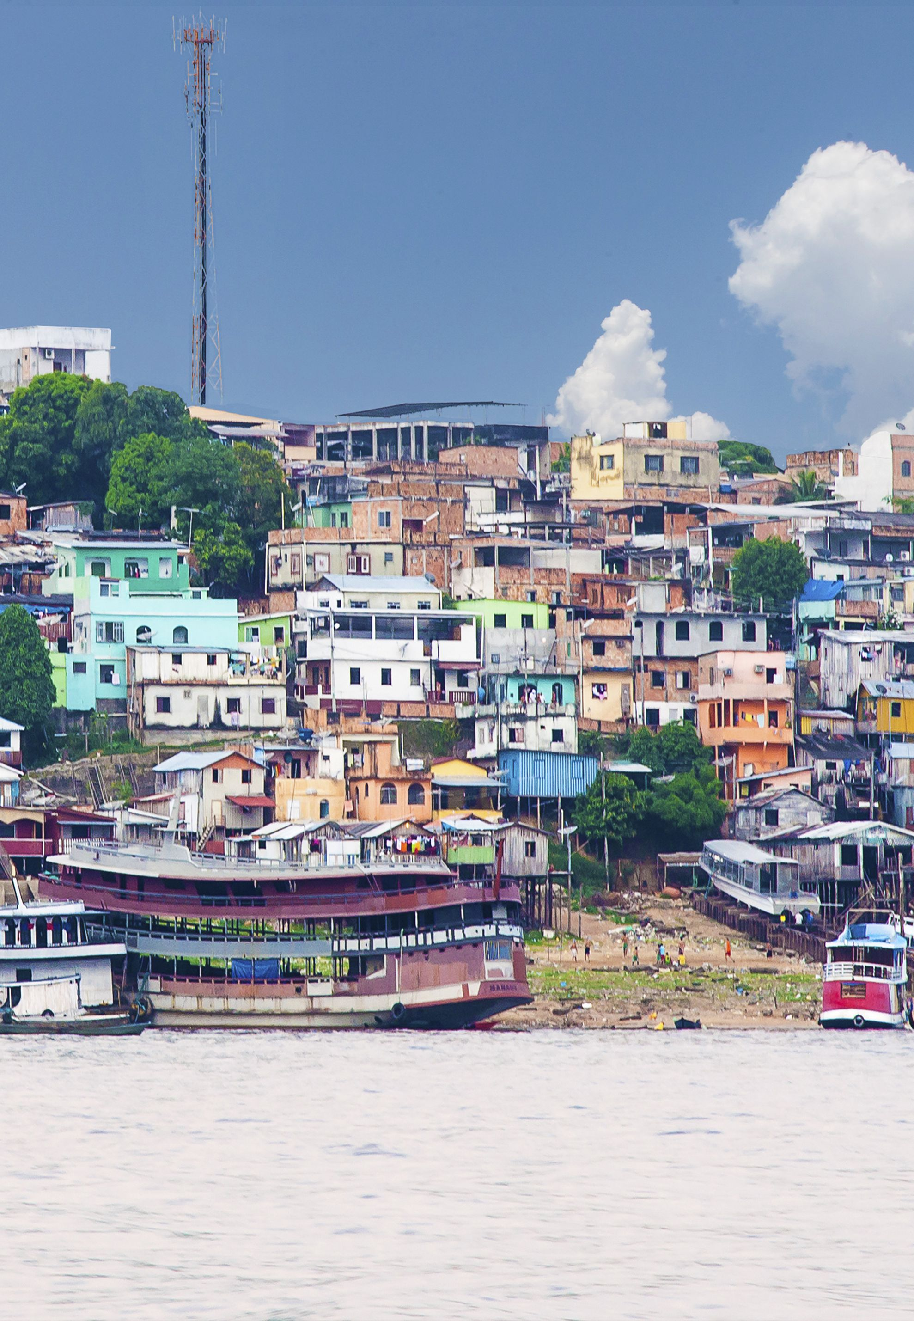
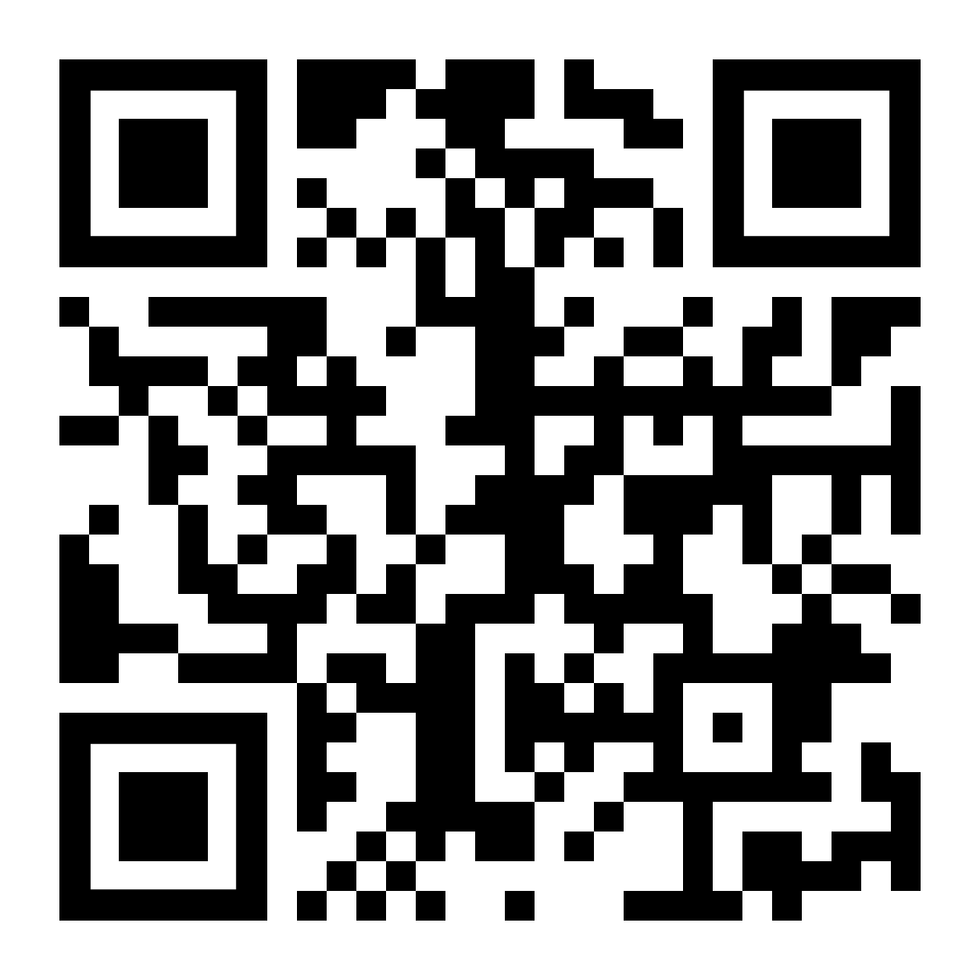
VIRTUAL BALLOON RACE
Launch Noon 2nd June Manaus, Amazonia
£3
Go to
https://ecoracing.co/user/page/1x3x
right now and buy lots of virtual balloons for Myxxcharity

Slide 2
£3
VIRTUAL BALLOON RACE
Launch Noon 2nd June Manaus, Amazonia
Go to
https://ecoracing.co/user/page/1x3x
right now and buy lots of virtual balloons for Myxxcharity

